Slide 1

Project Quack
Presented by
The Bestagons
Notes:
ore

Slide 2

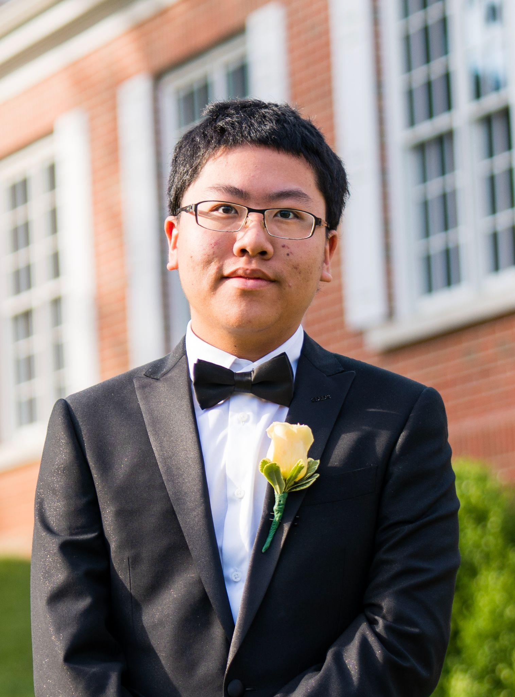

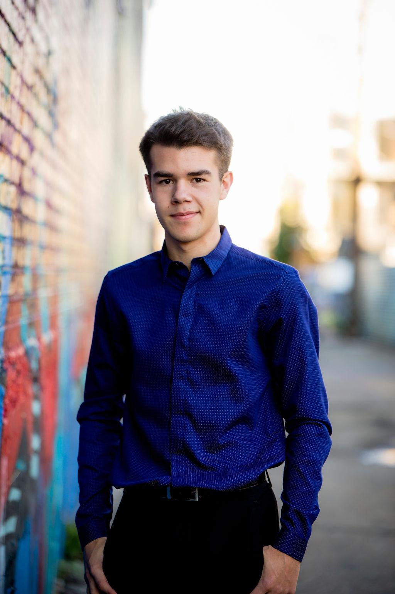
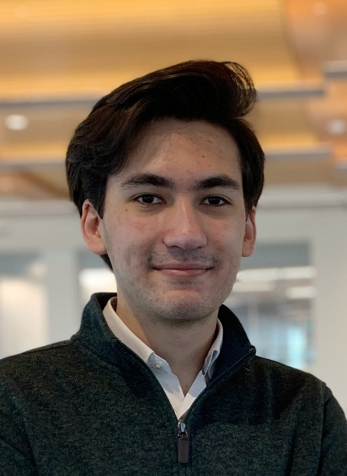
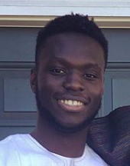
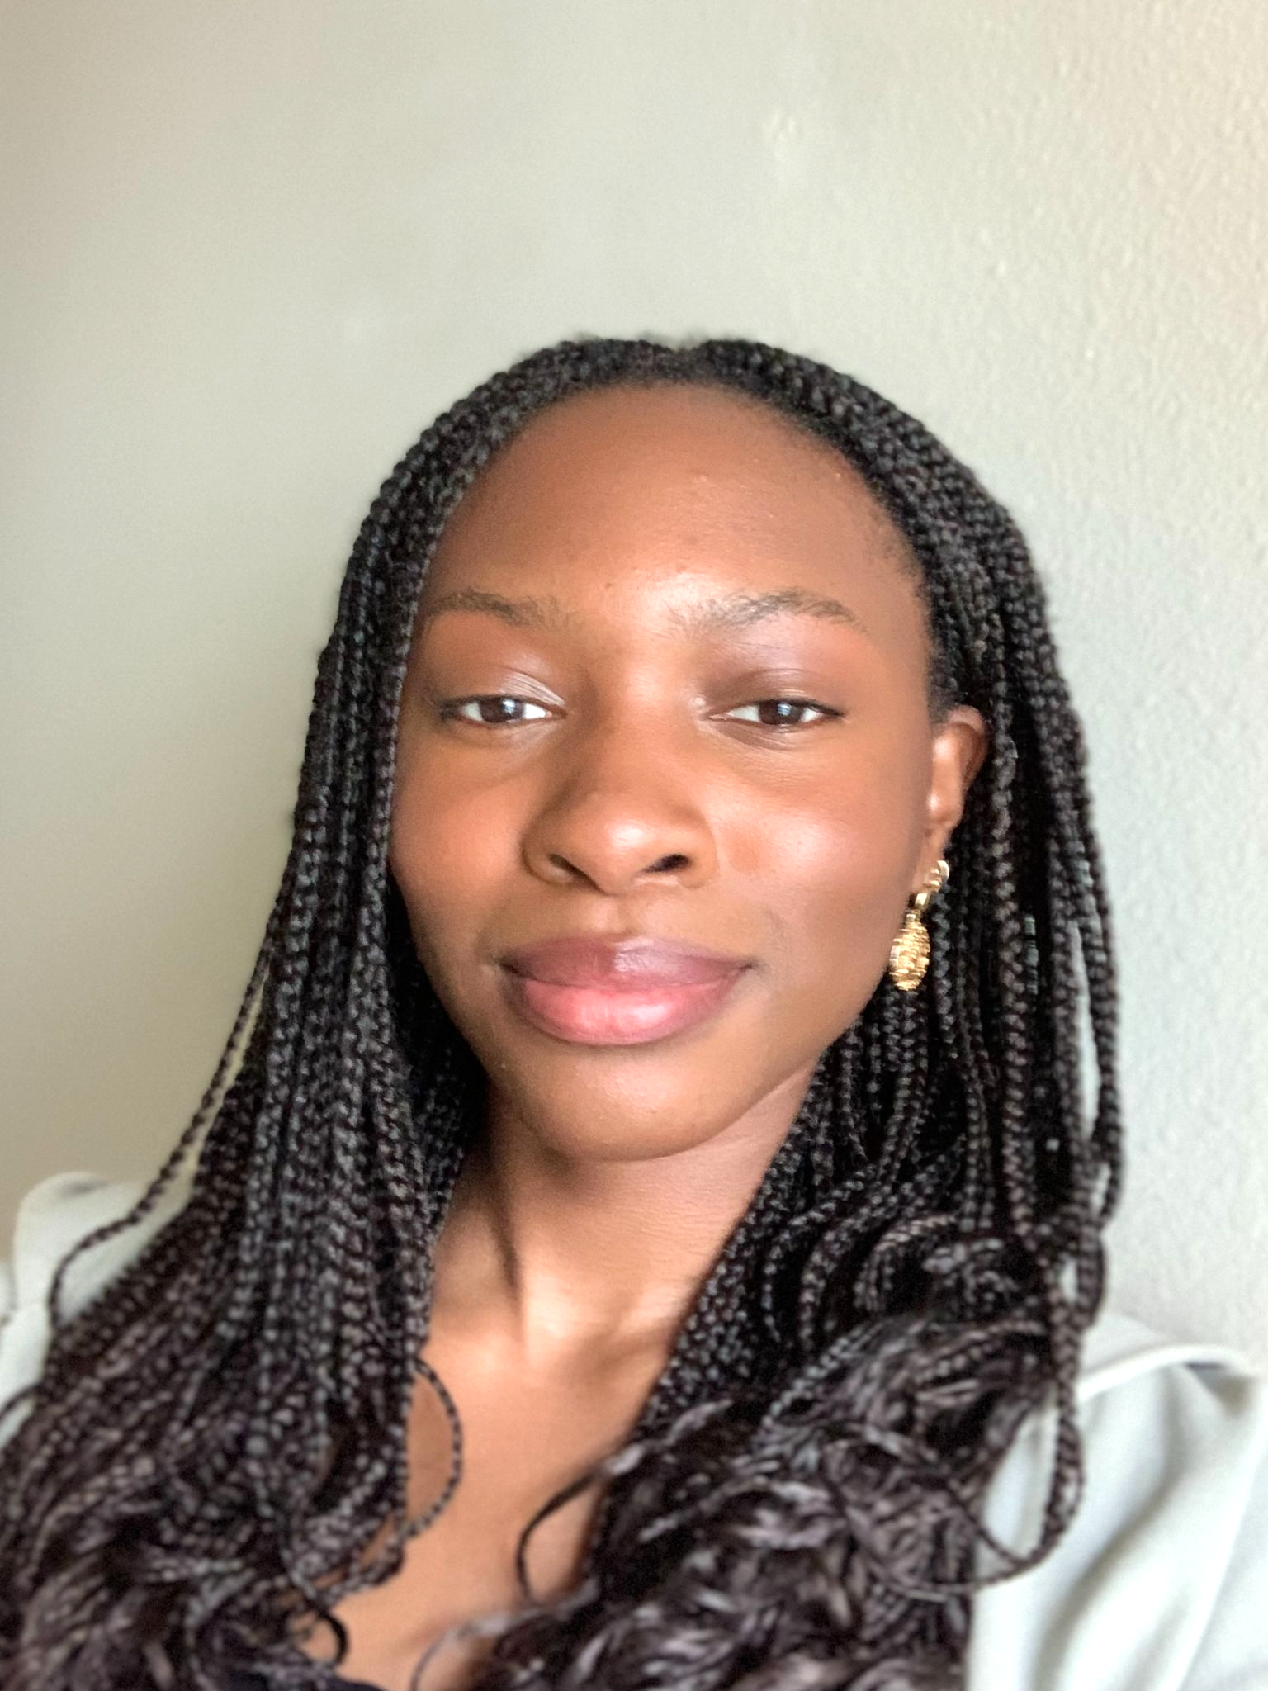
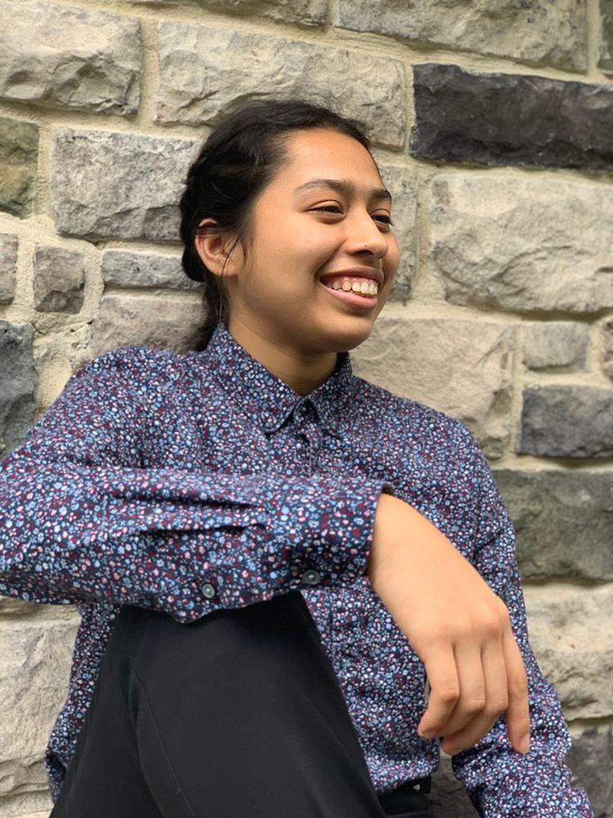
OUR TEAM
Miles Robertson
Rafael Piloto
Ore Adenikinju
Mimi Olayeye
Brenda Cano
David Wei
Product Owner
Scrum Master
Team member
Team Member
Team Member
Team member
Notes:
Ore
Make all our names the color of the Bestagons logo? No it will blend together

Slide 3
AGENDA
01
03
02
Acknowledging Feedback
What are our goals for the week?
What did we accomplish?
Notes:
ore

Slide 4
01
Acknowledging Feedback
Notes:
Ore

Slide 5
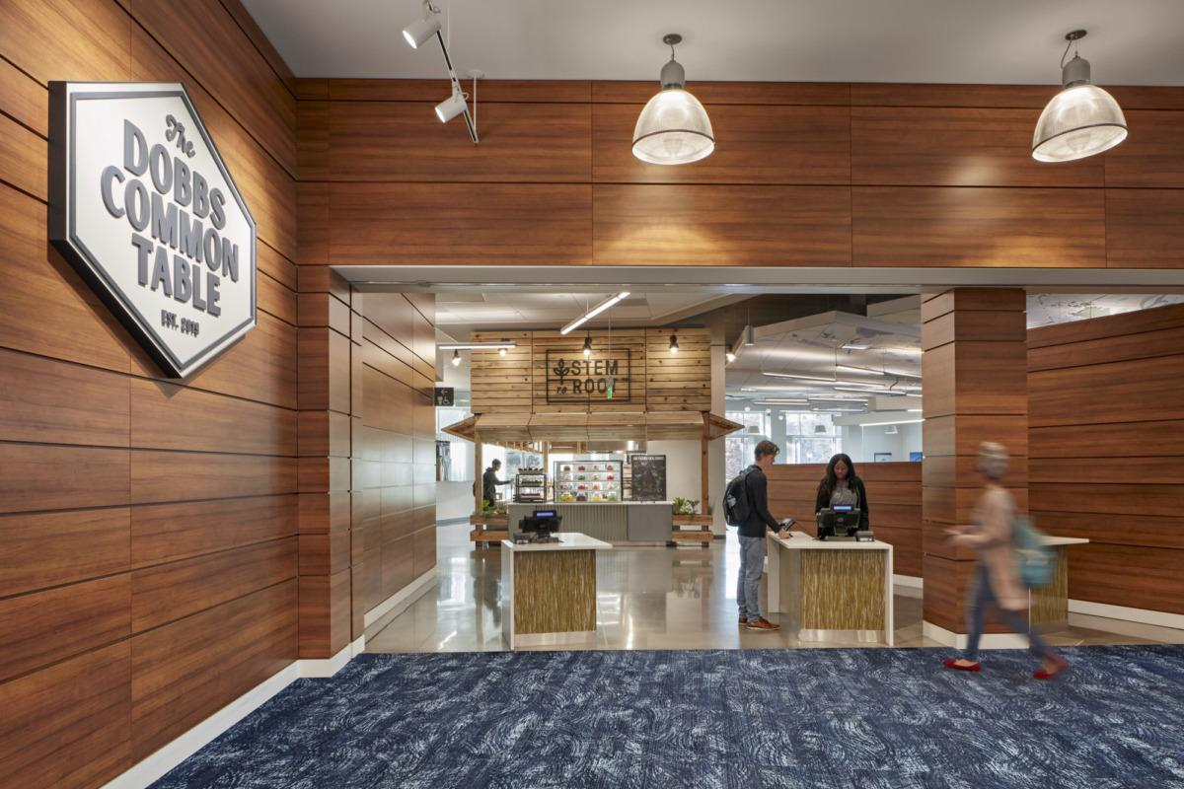
DCT Map-Flow
How were the estimations made (potential bias)
Scalability
Fixed weights vs dynamic weights
Permissions by Emory
What is our solution to Emory not allowing us to access their data
Notes:
Brenda

Slide 6
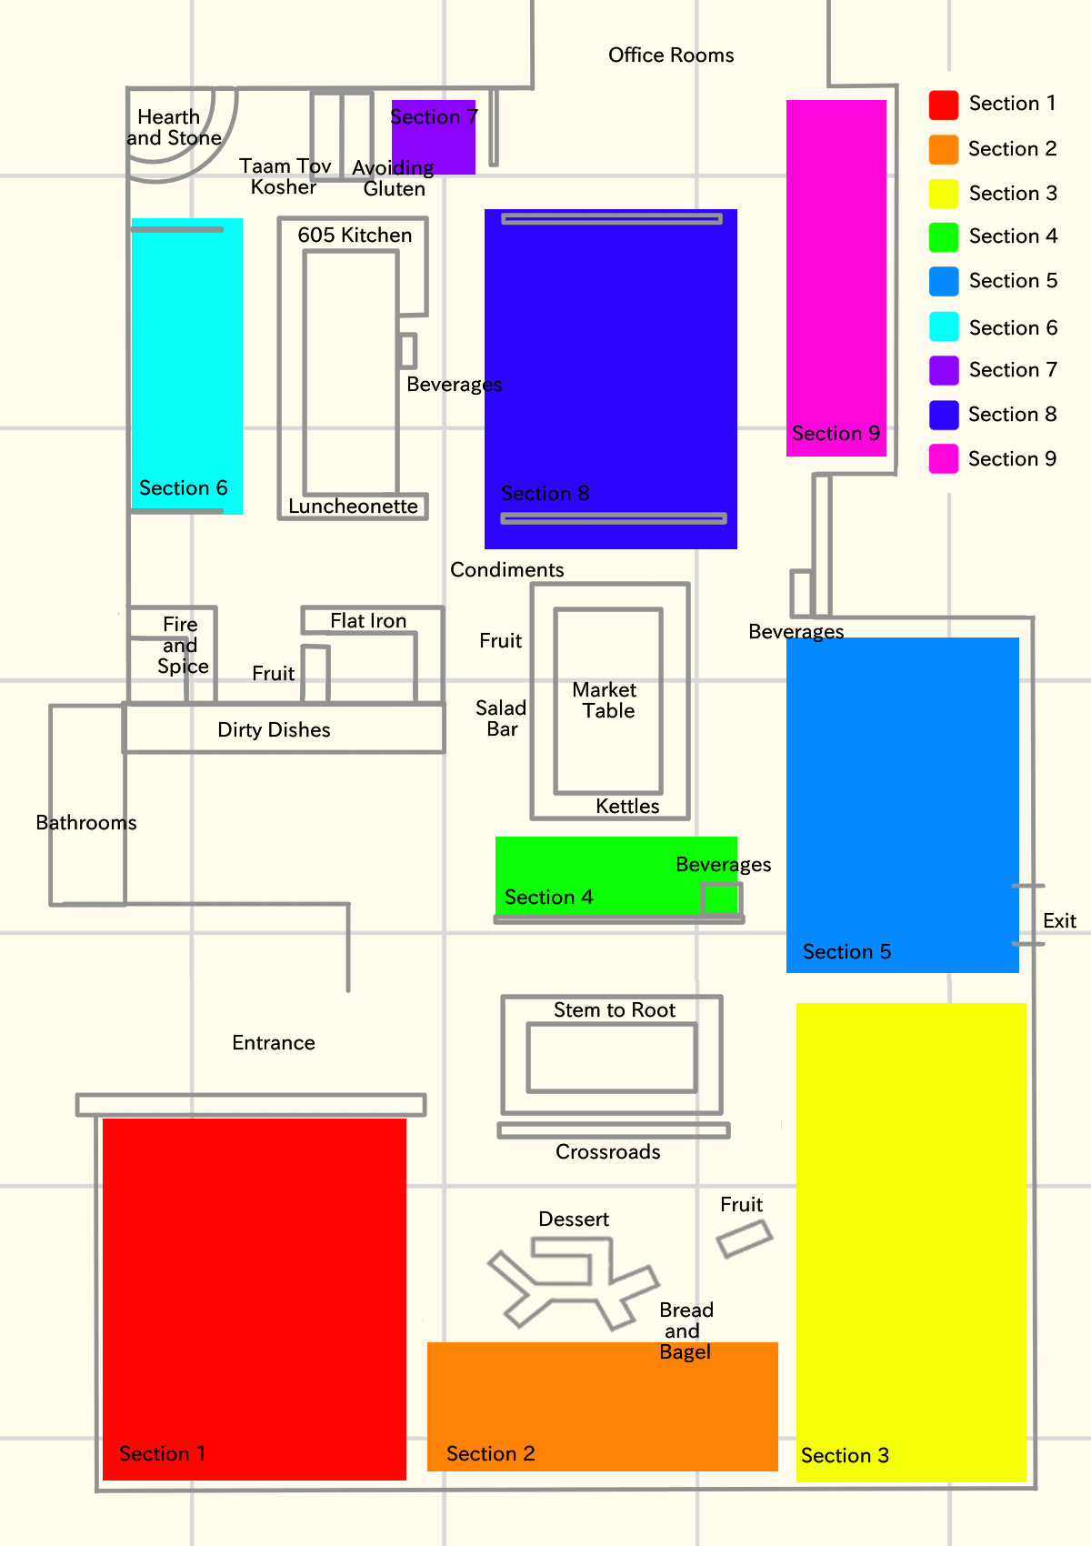
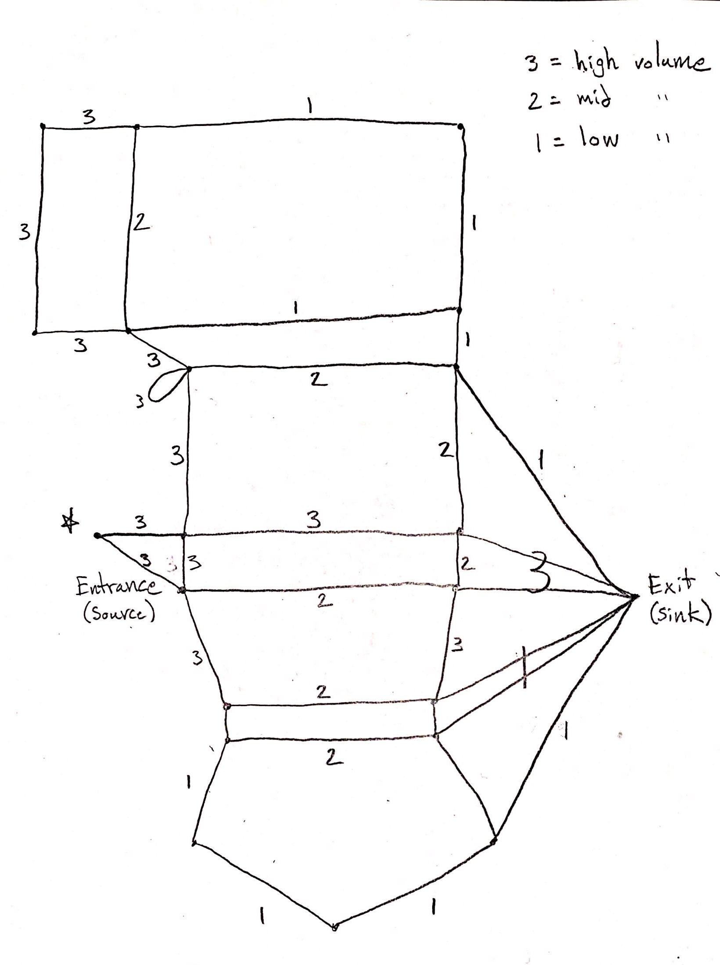
Notes:
Mimi
“Just as a reminder of what we mean by map flow, here is the map of the DCT we are using and its corresponding map flow”

Slide 7
DCT MAP-FLOW
Only designed for when DCT is operating at a high capacity, thus fixed weights are sufficient
Estimations were made by observation (yes, bias is possible if not probable)
It is as scalable as the network it models (DCT’s architecture)*
We please ask for no further feedback on the flow network as it is not a primary feature
*Both are not very scalable
Notes:
Miles
In response to the feedback we got...

Slide 8
PERMISSIONS FROM EMORY
Examples of some questions we got
Will Emory allow us to access Dooley Dollar/meal swipe data?
Will Emory allow us to set up cameras in the dining hall?
We are working on a proof of concept (POC). Creating an app with the potential to connect with Emory’s data and display your meal swipe amount or to keep track of the people swiping into the DCT or to set up cameras
It is important to remember that we are learning the Scrum methodology and we only have 10 sprints thus we are limited in what we can do
We are mocking the data for this POC so that in the future we have the potential to connect to real data
Notes:
Brenda

Slide 9
02
What did we accomplish?
Notes:
David

Slide 10
Pair Programming
WHO
David & Ore
Debugging
The async modifier mixed the execution order of functions
CODING
Used a then closure to force UI update after data fetching
Now all 6 of our team members have participated in Pair Programming this semester.
Notes:
David

Slide 11
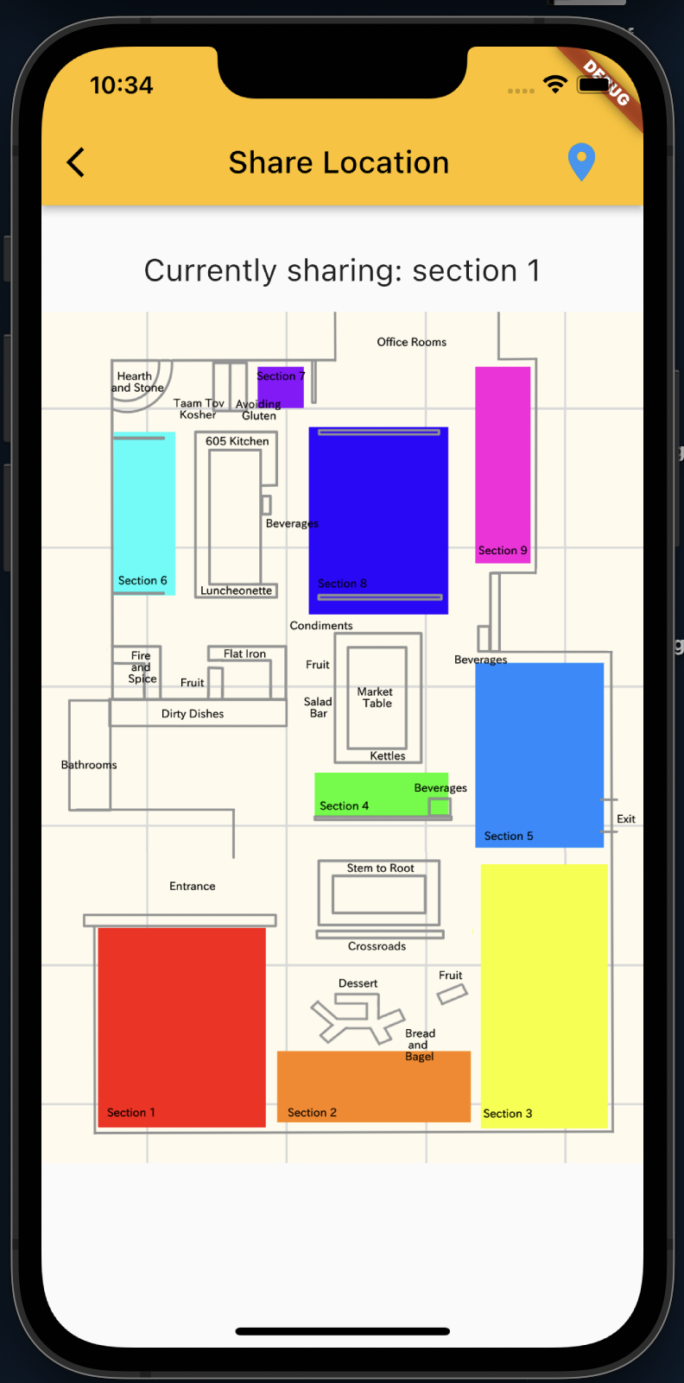
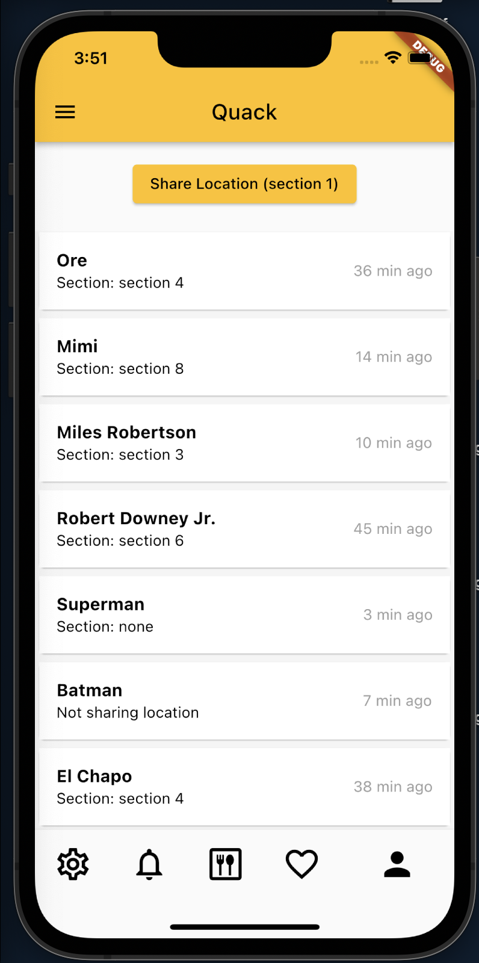
Where Am I? (Frontend)
Notes:
Ore: By Rafael -- needs voice - copy and paste into chat?
Left: Implemented map that can set the location shared by clicking on the respective section
Right: Shows what the front end will look-like when viewing friends and the location in which they are sharing

Slide 12
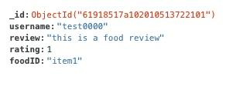
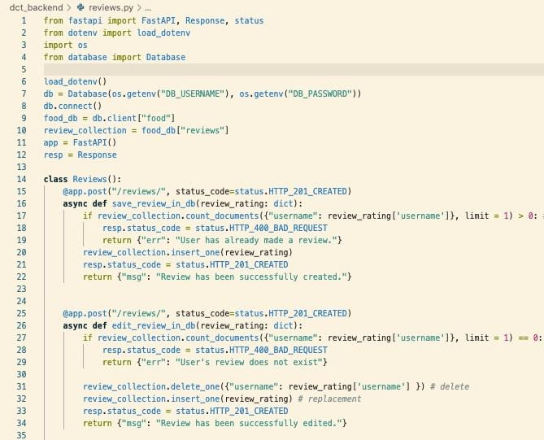
Food reviews
Created a new MongoDB collection “Reviews”
Schema Requirements: uuid, review, rating, and food item
Users can currently create a new review and edit existing reviews
Connected to Backend API
Next: Working to create a “get review” method (fetching from API)
Notes:
Mimi

Slide 13
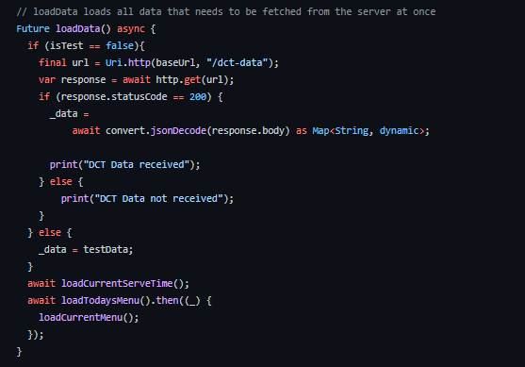
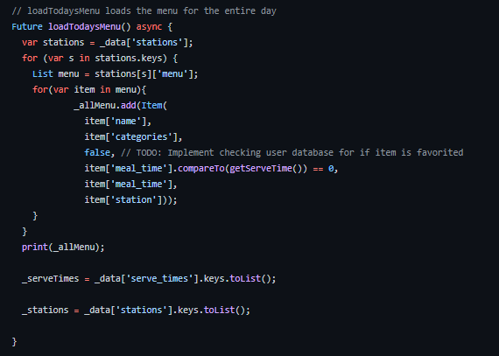
DCT Backend to Frontend Connection
Frontend now receives the necessary JSON data from the backend server and organizes it to work as intended. This includes:
Food Items (name, food category, calories, etc..)
Stations
Serve Times
Next step is to make the web scraper populate the backend server with the information taken from the Bon Appetit website.
Notes:
Ore

Slide 14
Scraper Demo!
Notes:
Miles

Slide 15
03
What are our goals for the week?
Notes:
Ore
Main focus is to further work on fully connecting our backend to front end

Slide 16
13 points
Ahead of schedule!
Notes:
Miles

Slide 17
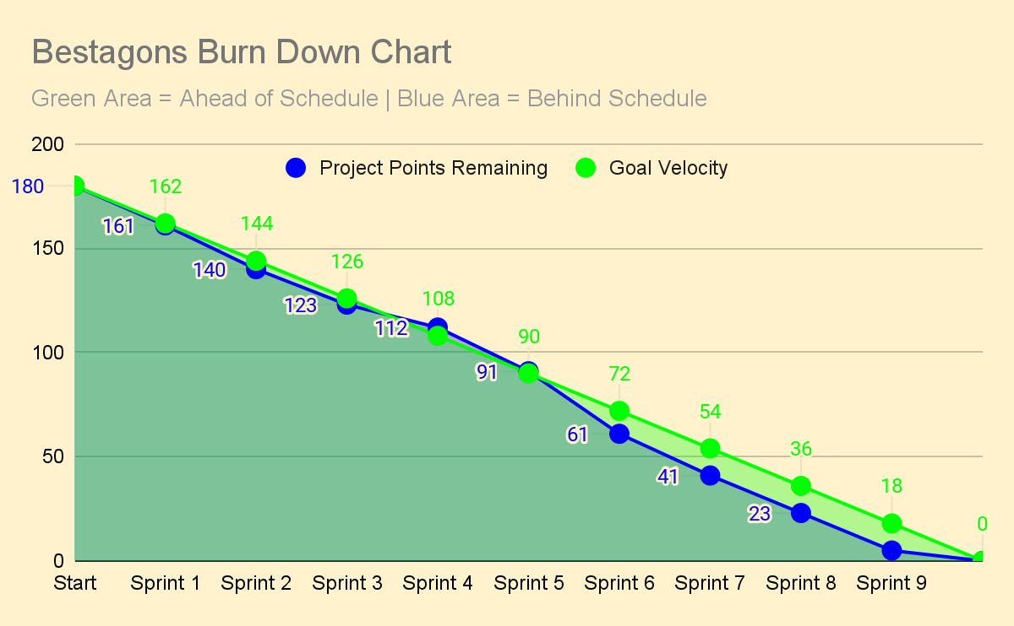
Notes:
Miles
Keep working ahead so that we can mostly take off Sprint 10 for Thanksgiving Break

Slide 18
THANKS
Please remember to share your feedback :)
Notes:
Miles

